Slide 1


OOPs in Java
Object-Oriented Programming (OOP) is a key programming concept in creating powerful and organized Java applications. In this presentation, we will explore the fundamental principles of OOP and the benefits of using OOP in Java.
Js
By Trupthi S Anand

Slide 2
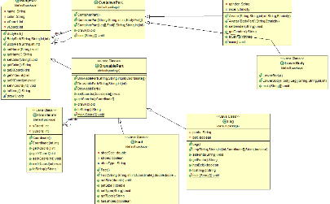
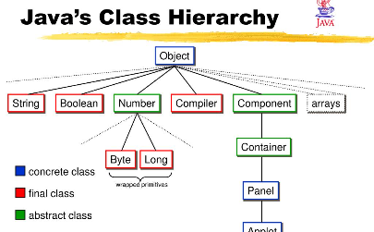
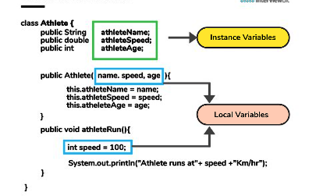
Objects and Classes
Objects in Java
Classes in Java
Creating Objects in Java
In Java, everything is an object. We'll explore the anatomy of objects and learn how to create and use them effectively in our applications.
Java classes define the blueprint for creating objects. In this section, we'll cover how to create classes and define their properties and behaviors.
Once you have defined a class, you can create objects from it. We'll show you how to create and initialize objects in Java.

Slide 3
Inheritance and Polymorphism
1
Inheritance
Inheritance allows us to create more specialized classes by extending existing classes. We'll explore how inheritance works in Java and how it can be used to improve code reuse.
Polymorphism
2
Polymorphism allows us to use objects of different classes interchangeably. We'll show you how to use polymorphism in Java, including method overriding and interfaces.

Slide 4
Encapsulation and Abstraction
Encapsulation
Abstraction
Encapsulation is the practice of hiding internal implementation details of classes. We'll explore how to use encapsulation to create secure and maintainable code.
Abstraction is the practice of simplifying complex systems by breaking them down into more manageable parts. We'll cover how to use abstraction in Java to make code more readable and reusable.

Slide 5
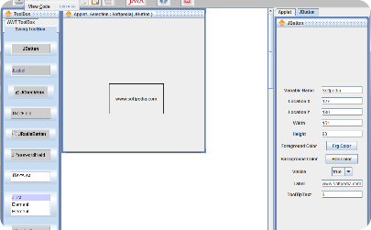
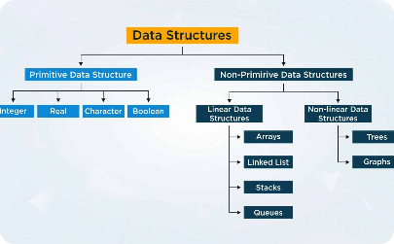
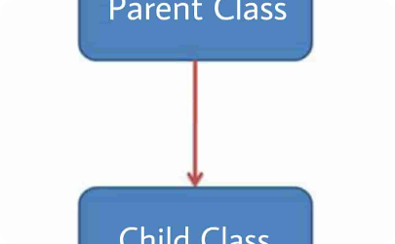
Using OOP in Java
User Interfaces
Data Structures
Inheritance in Action
Java's OOP features make it an ideal choice for developing user interfaces. We'll explore how to create beautiful and functional GUIs in Java.
OOP allows us to create powerful and efficient data structures. We'll show you how to use Java's collections framework to create data structures like lists, sets, and maps.
See how inheritance works in real-world applications. We'll show you some practical examples of how to use inheritance to simplify your code and improve its readability.

Slide 6

Best Practices in OOP in Java
1
Modularity
2
Code Reusability
Breaking code down into smaller modules helps it stay organized and easier to maintain. We'll explore some best practices for creating modular code in Java.
OOP's inheritance and polymorphism features allow for easy code reuse. We'll explore some best practices for making your code more reusable.
3
Testing
Testing is crucial in ensuring the effectiveness and maintainability of your code. We'll show you some best practices for testing object-oriented code in Java.

Slide 7
Conclusion
Summary
Importance in Java Development
We covered the fundamental principles of OOP and explored how it can be used effectively in Java. We also looked at a few best practices for creating maintainable, efficient, and reusable code.
OOP is a vital concept in modern Java development. By using OOP effectively, we can create powerful and efficient applications that are easier to maintain and expand.

